Slide 1
BIOMETRIC ACCESS FOR SECURE SMART ROBOT
TEAM MEMBER:
Nikhil Keshri(13BIT0004)
Shubham PAMECHA(13BIT0037)
RAVEESH KHATTAR(13BIT0140)
FACULTY GUIDE:
PROF. RAGHAVAN R

Slide 2
ABSTRACT
Biometrics, an important research field emerging fast, has growing challenges related to the secured access and security of the systems protected. In this paper, the secured access to a smart robot is proposed using biometrics. The robot can be accessed by recognizing the user’s finger print, acting as a password, and also operates on the voice-commands given by the speaker. The voice-commands are processed in real-time. The commands are processed in real-time using an on-line cloud server. The voice-commands converted to text form are sent via the Bluetooth network to a micro-controller on the robot, where these are interpreted and the smart robot performs the desired operation accordingly. The performance evaluation results of the finger print scanner and the voice commands signal processing are encouraging. Combining both the features makes the robot more robust. Few limitations of both the techniques have also been discussed with proposed solutions.

Slide 3
REQUIREMENTS
Hardware tools:
1. Arduino Mega
2. Voice control unit
3. Finger Print Scanner
4. Aduino LCD Board
5.Battery
6. Motor
Software tools:
Arduino IDE

Slide 4
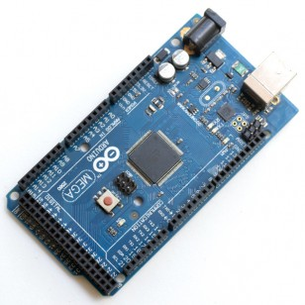
The Arduino Mega is a microcontroller board based on the ATmega1280 . It has 54 digital input/output pins (of which 14 can be used as PWM outputs), 16 analog inputs, 4 UARTs (hardware serial ports), a 16 MHz crystal oscillator, a USB connection, a power jack, an ICSP header, and a reset button.
Arduino Mega

Slide 5
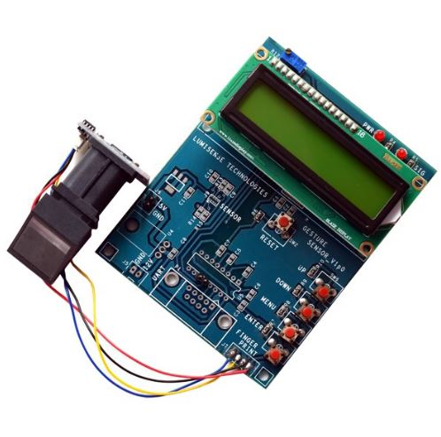
Fingerprint Scanner
Fingerprint module scanner for the demand of access control system, door lock, T&A and safety box OEM POS Consisting of high function DSP, large capacity FLASH and color CMOS, etc, SM621 optical fingerprint module can conduct fingerprint enrollment, image processing, templates storage, fingerprint matching and fingerprint searching. This Optical biometric fingerprint reader is with great features and can be embedded into a variety of end products, such as: access control, attendance, safety deposit box, car door locks.

Slide 6
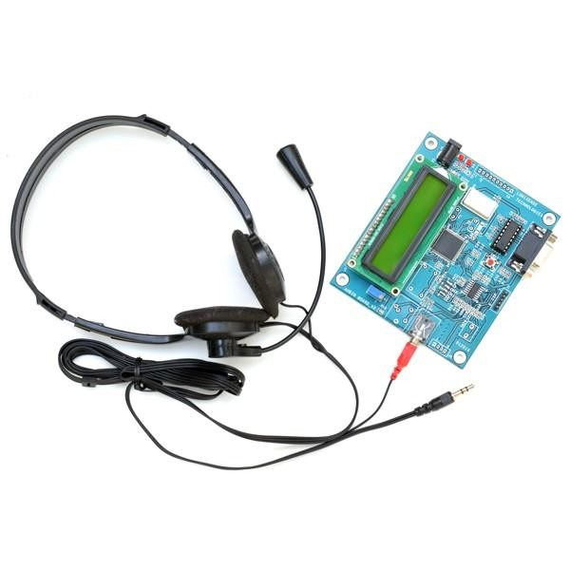
VOICE RECOGNITION BOARD
The voice recognition board is a completely assembled and easy to use programmable …speech recognition circuit. The commands that you need can be programmed to recognize. It has 8 bit data out which can be interfaced with 16-bit PIC microcontroller . The audio input from the microphone can be given through the audio jack assembled in this board . The input command with their corresponding characters can be displayed in LCD.

Slide 7
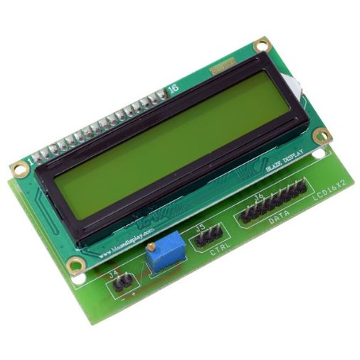
Arduino LCD Board
LCD board is specially designed for interfacing with Arduino. This board consists of two sections namely data and control sections. This board is provided with a potentiometer to adjust the LCD. The supply voltage to the board is given from the controller or from a separate source

Slide 8
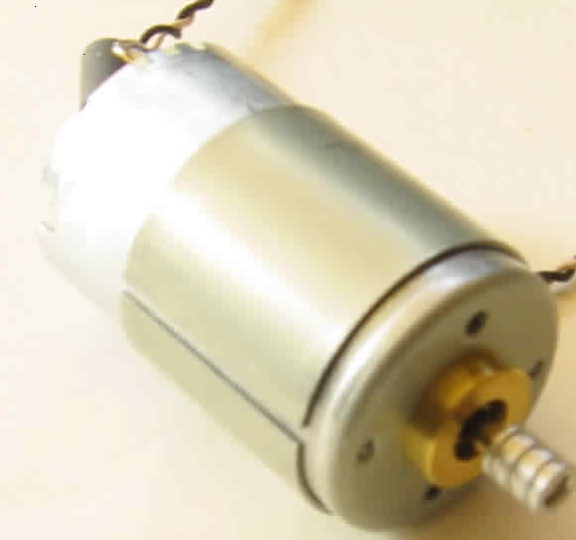
DC MOTOR
A DC motor is designed to run on DC electric power. Two examples of pure DC designs are Michael Faraday's homopolar motor (which is uncommon), and the ball bearing motor, which is (so far) a novelty.

Slide 9
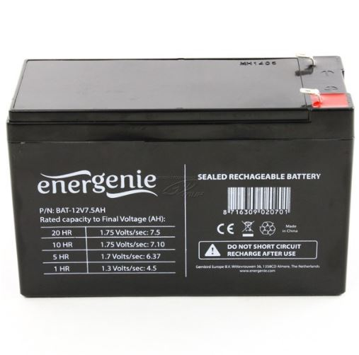
Battery
Batteries can be charged manually with a power supply featuring user-adjustable voltage and current limiting. 12v 7.5Ah lead acid battery is a rechargeable battery that supplies electrical energy. These batteries are designed to release a high burst of current and then quickly recharged. Six cells are connected in series in this battery. Another advantage is that running the battery completely down (i.e. leaving the parking light on for a week) will not damage the battery at all, unlike the SLA and Gel batteries, since it has a low-voltage disconnect circuit.

Slide 10
System Architecture

Slide 11
BLOCK DIAGRAM
Arduino uno
Buzzer
Matched/not matched
Matching database
Voice control
Input Finger Print
Motor drive
Finger Print Scanner
Motor

Slide 12
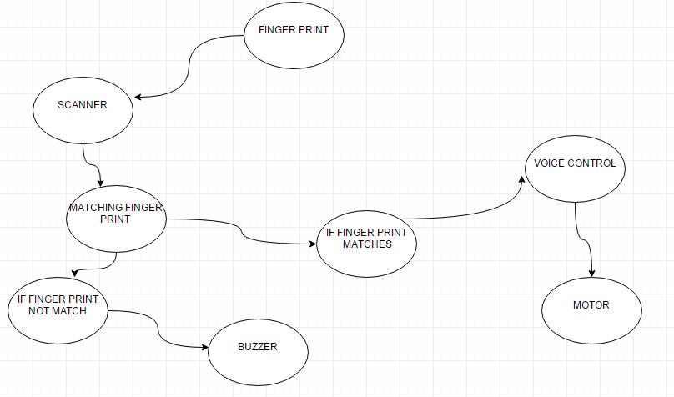
UML DIAGRAMS
Data Flow Diagram

Slide 13
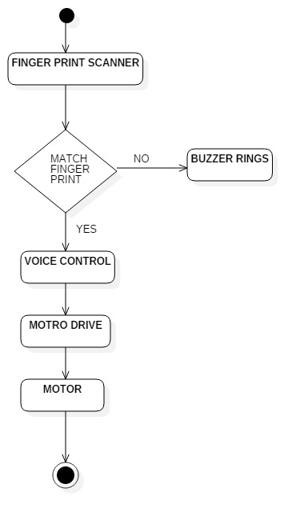
Activity Diagram

Slide 14
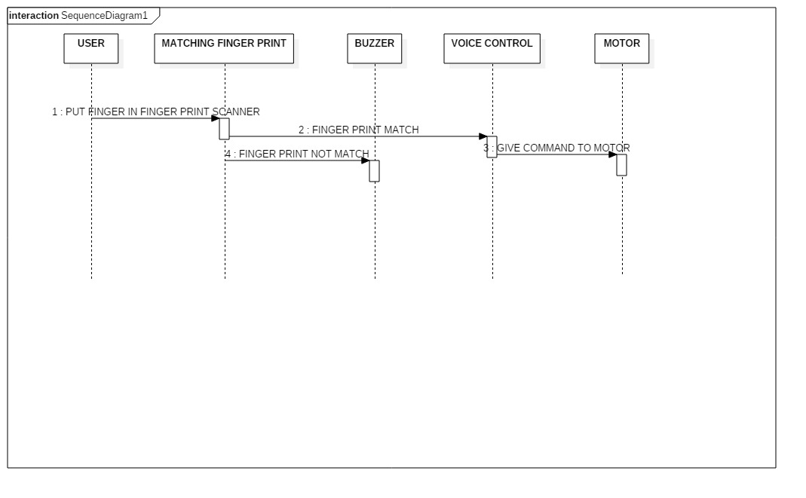
Sequence Diagram

Slide 15
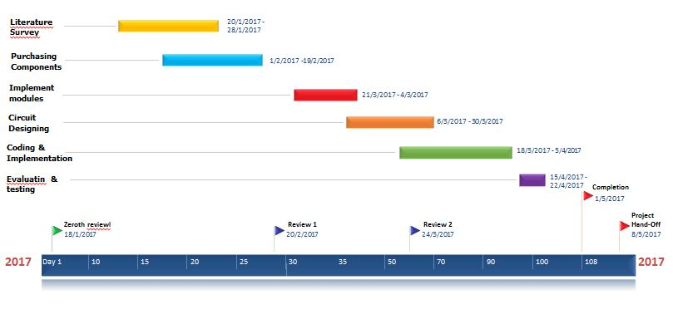
GANTT CHART

Slide 16
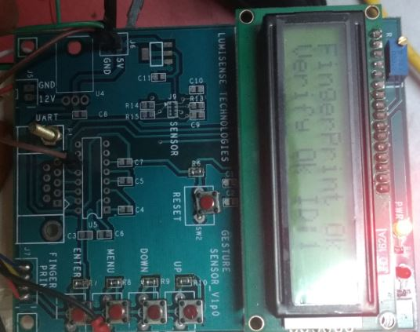
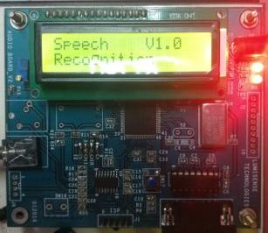
Result
Fingerprint gets verified
Voice Recognition Board enables when finger print matches

Slide 17
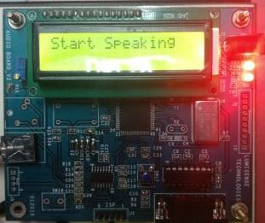
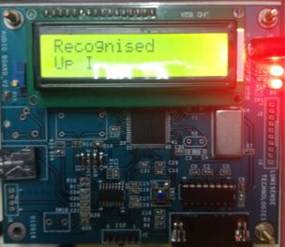
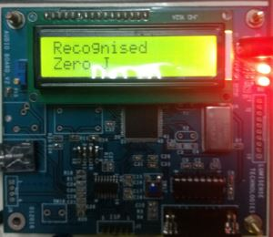
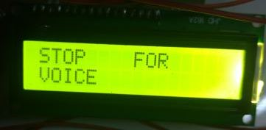
Voice Recognition Board ask user to give command to robot
When user gives up as voice command robot gets start moving.
Robot gets stop.
When user gives zero as voice command

Slide 18
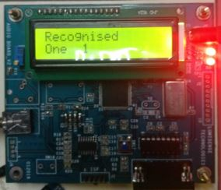
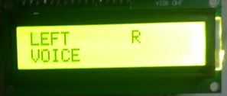
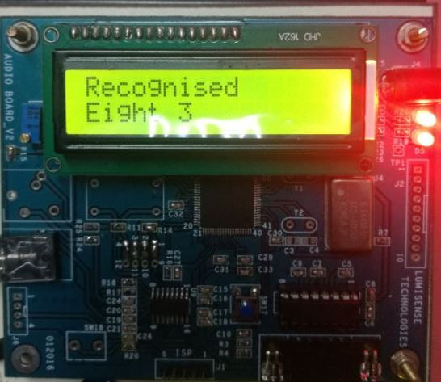
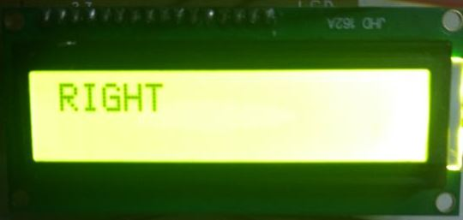
Robot moves left
When user gives one as voice command.
Robot moves left
When user gives eight as voice command.

Slide 19
Conclusion
The project led to in designing a smart robot which is accessed using user voice using voice recognition technique which is secured using biometric fingerprint scanner. It can be used in many of the automobiles where the door lock can be biometrically secured by finger print scanner and cars can be controlled through our voice using voice recognition technique . The voice-commands are processed in real-time. The project has reached its conclusion and left the team with many lessons learned.

Slide 20
REFFERENCE :
[1] A. J. Ijspeert, “Biorobotics: Using robots to emulate and investigate agile locomotion,” Science, vol. 346, no. 6206, pp. 196–203, Oct. 2014.
[2] Y. Kang, H. Kim, S. H. Ryu, N. L. Doh, Y. Oh, and B. J. You, “Dependable humanoid navigation system based on bipedal locomotion,” IEEE Trans. Ind. Electron., vol. 59, no. 2, pp. 1050–1060, Feb. 2012.
[3] N. Motoi, T. Suzuki, and K. Ohnishi, “A bipedal locomotion planning based on virtual linear inverted pendulum mode,” IEEE Trans. Ind. Electron., vol. 56, no. 1, pp. 54–61, Jan. 2009.
[4] K. Loffler, M. Gienger, F. Pfeiffer, and H. Ulbrich, “Sensors and control concept of a biped robot,” IEEE Trans. Ind. Electron., vol. 51, no. 5, pp. 972–980, Oct. 2004.
[5] S. Grillner, T. Deliagina, O. E. Manira, R. Hill, G. Orlovsky, P. Wall´en,
O. Ekeberg, and A. Lansner, “Neural networks that co-ordinate locomotion and body orientation in lamprey,” Trends Neurosci., vol. 18, no. 6, pp. 270 – 279, Jun. 1995.

